Slide 1
Barriers to Implementing a Just Culture
Challenges in Fostering Accountability, Learning, and Trust
By Roald Medendorp
CSD 380 assignment 9.2

Slide 2
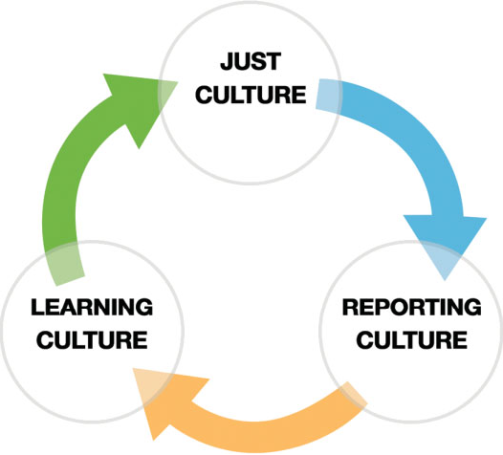
What is a Just Culture?
A culture that balances accountability with systemic learning, encouraging transparency without fear of unfair blame.
Focus on system improvement over individual punishment.
Open reporting of errors.
Fair accountability for reckless behavior.

Slide 3
Barrier 1 – Resistance to Change
Blame Culture Legacy:
Deep-rooted punitive practices in industries like healthcare, aviation, or manufacturing.
Fear of vulnerability: Employees hesitate to report mistakes due to past repercussions.
Dekker (2012) highlights blame cultures as a major obstacle to safety improvement.

Slide 4

Barrier 2 – Lack of Leadership Support
Leadership Role: Critical for setting tone and allocating resources.
Challenges:
Leaders may lack training in just culture principles.
Inconsistent messaging undermines trust.
An example would be Cybersecurity admin prioritizing speed over safety.

Slide 5
Barrier 3 – Inadequate Training
Employees: Unclear on differentiating human error vs. reckless behavior.
Managers: Struggle to apply just culture frameworks.
Solution: Regular workshops and scenario-based training.

Slide 6
Barrier 4 – Inconsistent Policy Application
Erosion of Trust:
Perceived favoritism or inconsistent disciplinary actions.
Example: Two nurses making similar errors, but only one faces punishment.
AHRQ (2019) notes inconsistency as a top barrier in healthcare.

Slide 7
Barrier 5 – Fear of Legal Repercussions
Worry that transparency could increase liability or reputational harm.
Legal systems often prioritize punishment over systemic fixes.
Example: Software companies avoiding incident reports to dodge lawsuits.

Slide 8

Barrier 6 – Resource Constraints
Time and Cost:
Training programs, reporting systems, and cultural audits require funding.
Staff shortages limit capacity for open dialogue.

Slide 9
Blame Culture vs. Just Culture
Blame Culture | Just Culture
Focuses on "Who?" | Focuses on "Why?"
Punishes errors | Learns from errors
Low reporting | High psychological safety

Slide 10
Conclusion & Recommendations
Summary: Key barriers include leadership gaps, fear, inconsistency, and resources.
Recommendations:
Engage leadership through workshops.
Standardize policies and invest in training.
Align legal/HR practices with just culture goals.
Closing Quote: "A just culture is a journey, not a checkbox." – Sidney Dekker

Slide 11
References
Dekker, S. (2012). Just Culture: Balancing Safety and Accountability.
AHRQ. (2019). Patient Safety Network.
Reason, J. (1997). Managing the Risks of Organizational Accidents.

